Slide 1





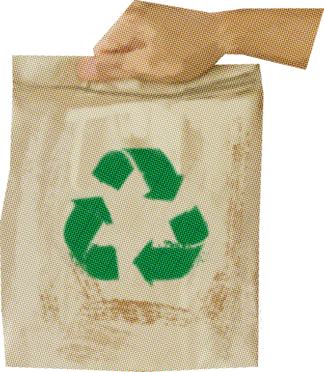
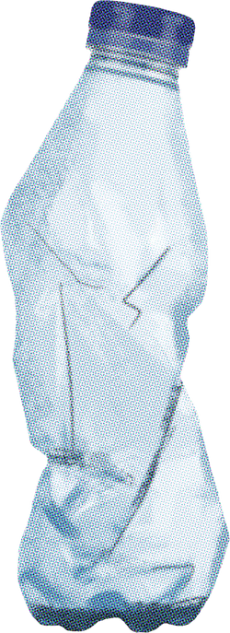
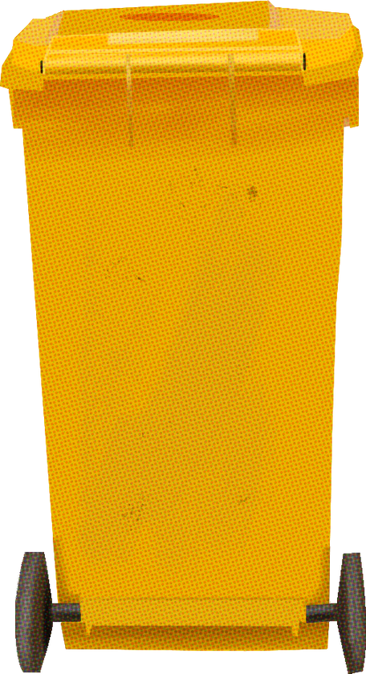
EPICS PROJECT : REVIEW - 2
SMART ECOSORT: WASTE SEGREGATION SYSTEM FOR EFFICIENT WASTE MANAGEMENT
SORT SMARTER, NOT HARDER
GROUP-81
SUPERVISOR : DR. ADARSH PATEL
REVIEWER : DR. ABHAY VIDYARTHI,
DR. ANKUR JAIN
1

Slide 2
GROUP MEMBERS
21BEC10040 Mohammad Sohel
21MEI10052 Lalit Sahu
21BEC10038 Aman Upadhyay
21BAC10037 Ashish Barpete
21BAC10038 Manish Meena
21BCE11564 Waris Hussain
21MIM10015 Mohammad Atiullah Shaikh
21BAI10056 Mirza Farhan Zaid
2

Slide 3
Index
Introduction
Literature Review
Research Gap
Problem Statement
Proposed Solution
Types of Waste
Implementation
Flowchart
System Design
Working
Challenges
Results
Future Scope
Conclusion
Working Plan
References
3

Slide 4

INTRODUCTION
Rapid urban growth spurs global rise in solid waste.
Urgent need for efficient waste management in smart cities.
Manual waste sorting poses health risks for workers.
Inadequate waste collection fuels pollution in urban areas.
4

Slide 5
LITERATURE REVIEW
1.Waste segregation and potential for recycling -A case study in Dar es Salaam City, Tanzania
RR - Reduce, Reuse, Recycle
Advantages: Promotes sustainable waste management practices, conserves resources, reduces environmental impact.
Disadvantages: Implementation may require significant infrastructure and behavioral changes, may face resistance due to perceived inconvenience or cost.
2. Automatic Waste Segregator as an integral part of Smart Bin for waste management system in a Smart City
Advantages:
Addressing a Critical Issue: The paper tackles a significant problem faced by modern urban areas – efficient waste management. With urbanization on the rise, there's a pressing need for solutions like the Automatic Waste Segregator (AWS) to handle the increasing volume of waste.
Disadvantages:
Limited Scope of Evaluation: While the experimental results demonstrate the effectiveness of the AWS system, the evaluation may be limited in terms of the scale and diversity of waste types tested. A broader evaluation encompassing a wider range of waste scenarios could provide more robust validation.
4

Slide 6
LITERATURE REVIEW
3.Waste Separation Smart Dustbin
Advantages:
Innovative Solution Approach: The proposed waste separation smart dustbin represents an innovative approach to waste management. By integrating proximity sensors, moisture sensors, and a microcontroller, the system offers a technologically advanced solution to automate waste segregation.
Disadvantages:
Sensor Limitations and Accuracy: The testing results reveal limitations in sensor accuracy, particularly in detecting certain waste types using capacitive proximity sensors. This raises concerns about the reliability of the system in real-world scenarios and the need for further refinement or alternative sensor technologies.
4. Smart Bin: An Efficient Waste Disposal and Segregation System
Advantages:
Hands-Free Operation: The automatic door opening system, triggered by ultrasound sensors, ensures hands-free garbage disposal, enhancing hygiene and user convenience.
Disadvantages:
Cost of Implementation: The initial setup and installation costs of the Smart Bin, including components such as ultrasound sensors, microcontroller, and Bluetooth module, may be prohibitive for some users or municipalities, limiting widespread adoption.
4

Slide 7
RESEARCH GAP
Implementation Challenges: Gap in addressing infrastructure requirements and behavioral barriers hindering system adoption due to perceived inconvenience or cost.
Limited Evaluation Scope: Lack of comprehensive validation in experimental evaluations, especially regarding diverse waste scenarios, restricting the system's effectiveness assessment.
Sensor Accuracy Issues: Concerns about sensor accuracy, particularly with capacitive proximity sensors, impacting reliability in real-world scenarios, necessitating further research on refinement or alternative sensor technologies.
Cost-Prohibitive Setup: Gap in mitigating prohibitive setup costs, including components like ultrasound sensors, hindering widespread adoption, requiring exploration of cost-effective solutions.
5
Notes:
Good [morning/afternoon/evening], everyone! I'm Waris, and today I'm here to shed light on a critical issue that demands our attention — the current state of waste management. Did you know that the 3 Rs — Reduce, Reuse, Recycle — are informally practiced, with weak regulatory frameworks hindering effective waste management? By 2025, waste generation in India may reach 0.7kg/person/day, and food waste already contributes over 60% in households. These numbers paint a concerning picture, demanding urgent solutions.
"Now, let me introduce our innovative solution — a smart dustbin designed to revolutionize waste segregation. This dual-compartment dustbin, equipped with automated sensors, can distinguish between biodegradable and non-biodegradable waste. In real-time, it provides essential data on usage, weight, and fullness, optimizing waste collection planning. Our project aligns seamlessly with the need for efficient waste management, addressing the challenges posed by weak regulations and the informal practice of the 3 Rs. By automating waste separation, we reduce health hazards for waste workers, improve recycling and reuse, and contribute to smart city initiatives.

Slide 8

PROBLEM STATEMENT
Develop an intelligent waste segregator system using machine learning.
Automatically capture waste images and classify them (biodegradable or non-biodegradable) based on visual features.
Capture waste images using cameras.
Utilize machine learning to analyze visual features and classify waste.
Implement segregation mechanism based on classification results.
Ensure high accuracy to minimize segregation errors.
5
Notes:
Good [morning/afternoon/evening], everyone! I'm Waris, and today I'm here to shed light on a critical issue that demands our attention — the current state of waste management. Did you know that the 3 Rs — Reduce, Reuse, Recycle — are informally practiced, with weak regulatory frameworks hindering effective waste management? By 2025, waste generation in India may reach 0.7kg/person/day, and food waste already contributes over 60% in households. These numbers paint a concerning picture, demanding urgent solutions.
"Now, let me introduce our innovative solution — a smart dustbin designed to revolutionize waste segregation. This dual-compartment dustbin, equipped with automated sensors, can distinguish between biodegradable and non-biodegradable waste. In real-time, it provides essential data on usage, weight, and fullness, optimizing waste collection planning. Our project aligns seamlessly with the need for efficient waste management, addressing the challenges posed by weak regulations and the informal practice of the 3 Rs. By automating waste separation, we reduce health hazards for waste workers, improve recycling and reuse, and contribute to smart city initiatives.

Slide 9


WHY?
Automates waste separation to reduce health hazards of manual sorting for waste workers.
Enables accurate categorization of different waste types to improve recycling and reuse.
Provides real-time data on waste generation patterns to inform management policy.
Aligns with smart cities mission by integrating sensor and internet-connected technologies for public services.
6
Notes:
First read the slide then,
In short, our project offers more than just a solution; it's a step towards a cleaner, healthier future. As we grapple with increasing waste generation, our smart dustbin introduces efficiency, data-driven planning, and a significant contribution to environmental well-being. Now, I invite [name of next member] to continue the presentation forward.

Slide 10
PROPOSED SOLUTION
Waste Segregator :
Creating a waste segregator.
Utilizing ML and Raspberry Pi.
Garbage will segregate automatically based on its properties such as, Biodegradable and Non-Biodegradable.
8

Slide 11
TYPES OF WASTE
ORGANIC
RECYCLABLE
HAZARDOUS
This includes food scraps, yard waste, vegetable peels, and other bio-degradable substances.
This includes plastic, glass, metals, and other materials that can be reprocessed into new products.
This includes substances like paints, CFL bulbs, electronics, cleaning agents, and others that require special handling.
BIODEGRADABLE
NON- BIODEGRADABLE
7

Slide 12
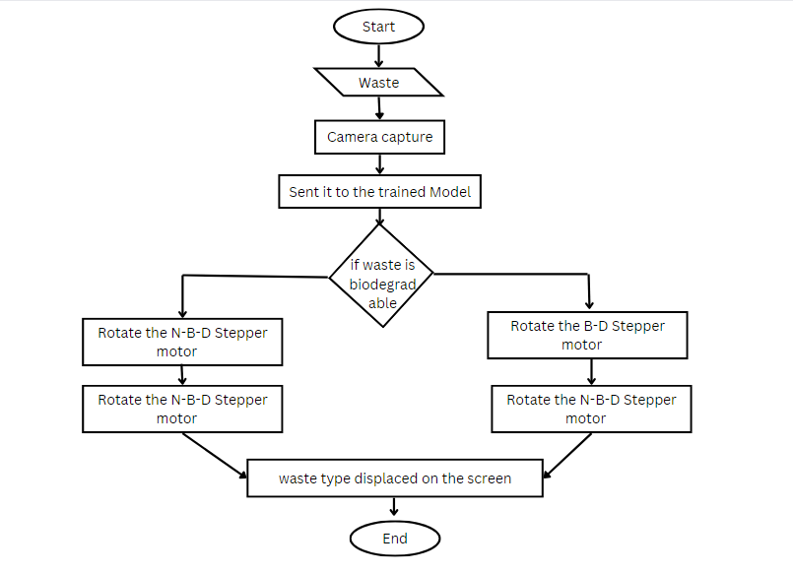
FLOW CHART
T
11

Slide 13
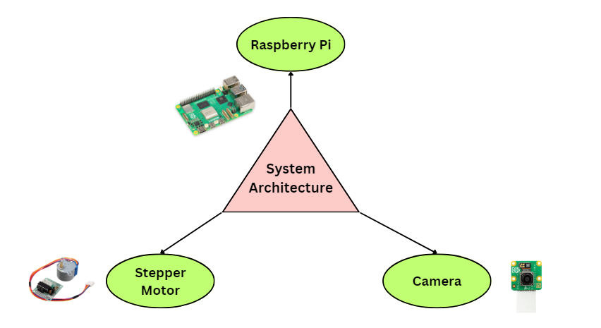
SYSTEM DESIGN
COST-EFFECTIVE
LOW POWER CONSUMPTION
EFFICIENT
10

Slide 14
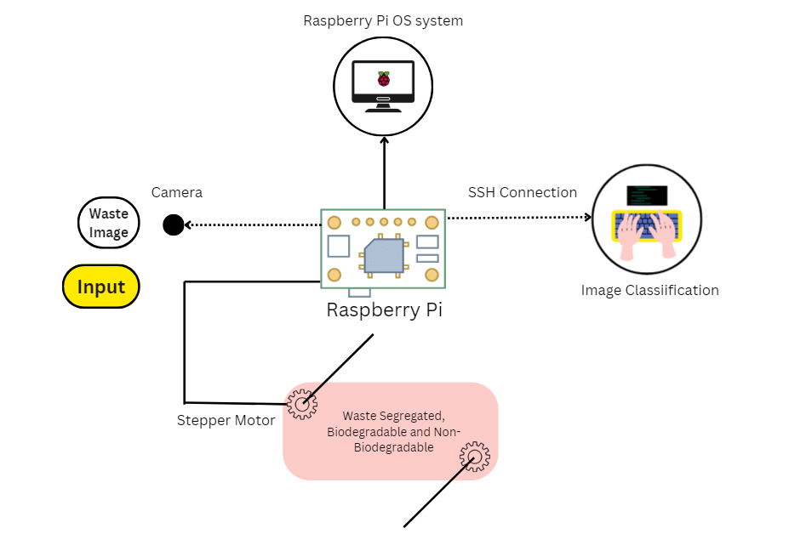
WORKING
Image Capture
Machine Learning
Decision time
Stepper Motor Action

Slide 15
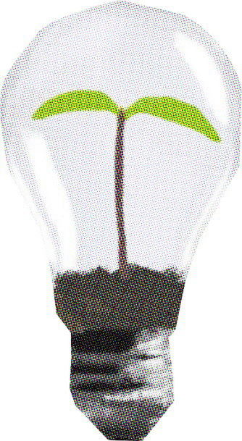

CHALLENGES
Image Quality: Ensuring clear, well-lit images for accurate analysis.
Training Data: Collecting diverse labeled images for effective machine learning.
Model Selection: Choosing the right algorithm and tuning its parameters.
Real-Time Processing: Achieving low latency for quick decision-making.
12

Slide 16
RESULT
Efficient waste management:
Reduced contamination.
Increased recycling potential.
Improved health and environmental impact:
Less reliance on rag pickers.
Proper waste disposal.
Economic value realization:
Recycling opportunities.
Waste-to-energy possibilities (e.g., syngas generation).
12

Slide 17
FUTURE SCOPE
Smart City Integration - Smart Waste Management: Collaborate with city authorities to integrate your waste segregator into smart city infrastructure.
Public Spaces and Parks: Install waste segregators in public parks, recreational areas, and tourist spots.
Residential Complexes and Housing Societies: Implement waste segregators in apartment complexes and gated communities.
Educational Institutions: Schools and colleges can adopt waste segregators.
Industrial Zones and Commercial Areas: Factories, warehouses, and commercial hubs generate substantial waste.
12

Slide 18
CONCLUSION
Addressing research gaps is crucial for successful waste segregator system development and adoption.
Overcoming infrastructure challenges and behavioral barriers is essential for seamless implementation.
Comprehensive evaluations are necessary to validate system effectiveness across diverse waste scenarios.
Improving sensor accuracy is vital for reliable real-world deployment.
Efforts to reduce setup costs are necessary for widespread adoption and realizing environmental benefits.
12

Slide 19
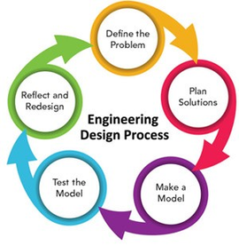




WORKING PLAN
5-Milestones
4
Review 1
Required equipment
Documentation
60% Hardware till review-2
Research
&
Ideation
Finalize Idea
&
work Distribution
3
10% WORK END OF THE JAN
30% HW END OF THE FEB
TESTING AND ITERATION
60% HW TILL REVIEW-2
2
1
5
13

Slide 20
REFERENCES
W. Pereira, S. Parulekar, S. Phaltankar and V. Kamble, "Smart Bin (Waste Segregation and Optimisation)," 2019 Amity International Conference on Artificial Intelligence (AICAI), Dubai, United Arab Emirates, 2019, pp. 274-279, doi: 10.1109/AICAI.2019.8701350
Jacob M. Kihila, Kris Wernsted & Mengiseny Kaseva (2021) Waste segregation and potential for recycling -A case study in Dar es Salaam City, Tanzania, Sustainable Environment, 7:1, DOI: 10.1080/27658511.2021.1935532
Gour, A. A., & Singh, S. K. (2022). Solid Waste Management in India: A State-of-the-Art Review. Environmental Engineering Research, 28(4), 220249–0. https://doi.org/10.4491/eer.2022.249
Batais, R., Abdulla, R., & Bahrin, S. M. (2020). Waste separation smart dustbin. ResearchGate. https://www.researchgate.net/publication/341878744_Waste_Separation_Smart_Dustbin
C. P. Singh, M. Manisha, P. -A. Hsiung and S. Malhotra, "Automatic Waste Segregator as an integral part of Smart Bin for waste management system in a Smart City," 2019 5th International Conference On Computing, Communication, Control And Automation (ICCUBEA), Pune, India, 2019, pp. 1-5, doi: 10.1109/ICCUBEA47591.2019.9129508.
N. H. Kamarudin, A. A. A. Rahim, N. E. Abdullah, I. S. A. Halim and S. L. M. Hassan, "Development of Automatic Waste Segregator with Monitoring System," 2019 4th International Conference on Information Technology, Information Systems and Electrical Engineering (ICITISEE), Yogyakarta, Indonesia, 2019, pp. 190-195, doi: 10.1109/ICITISEE48480.2019.9003813.
14

Slide 21

15

